Slide 1
§6.4 Circular waveguide cavities
a cylindrical cavity resonator can be constructed from a section of circular waveguide shorted at both ends
z
l
r
ϕ
2a
TE or TM resonant mode
Notes:
Cylinder resonator

Slide 2
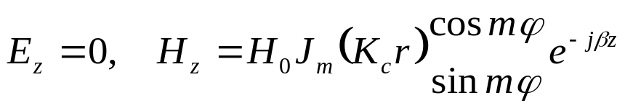
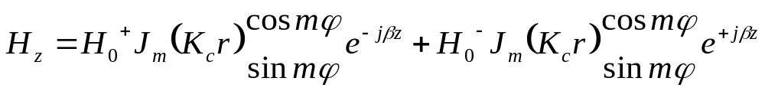
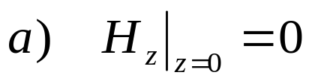

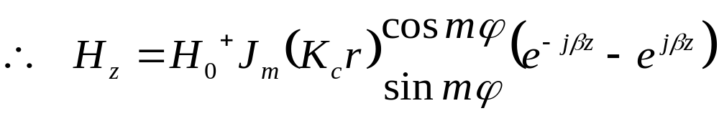
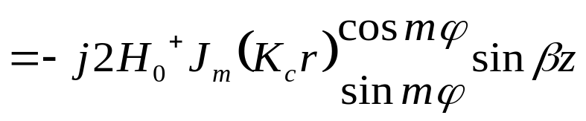
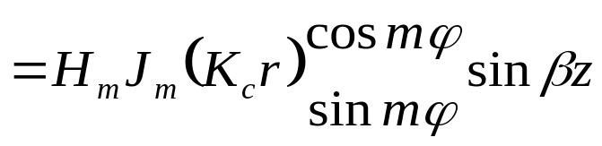
§6.4 Circular waveguide cavities
1. TE /TM resonant mode
（1）TE_{mnp}

Slide 3
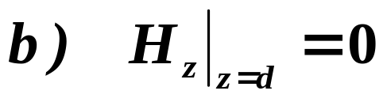
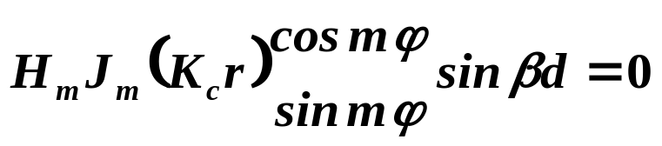

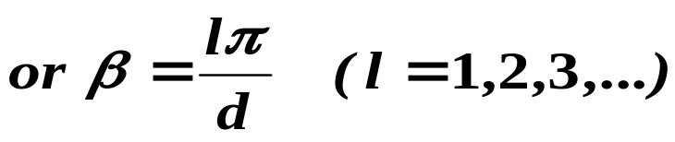
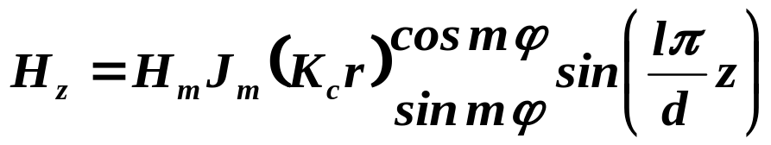
§6.4 Circular waveguide cavities

Slide 4
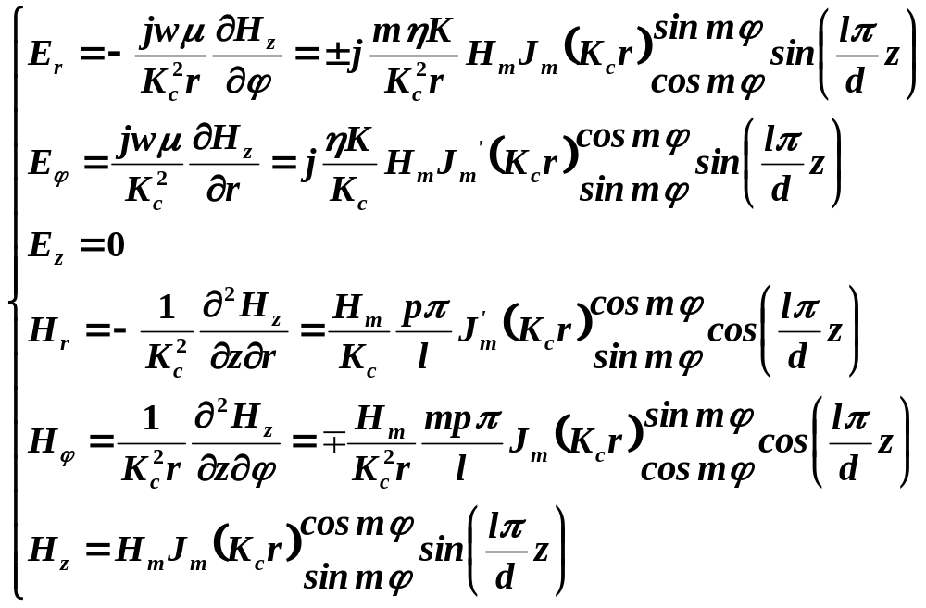
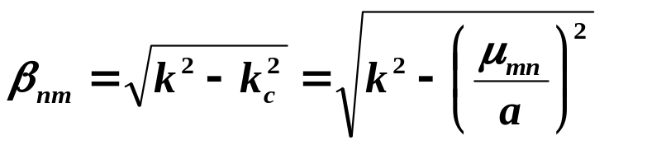
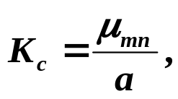
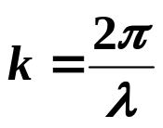
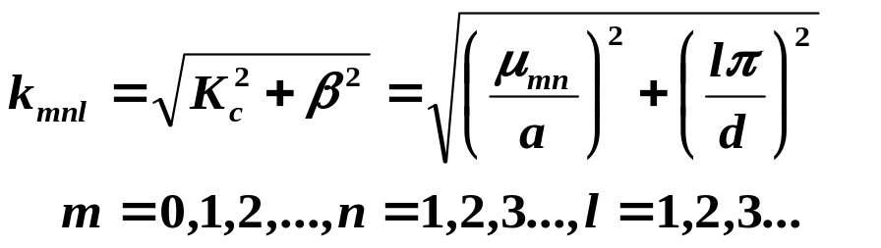
§6.4 Circular waveguide cavities

Slide 5
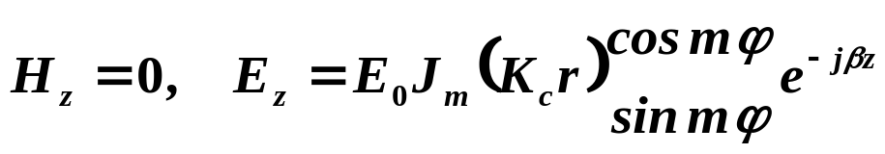
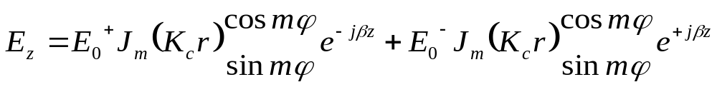
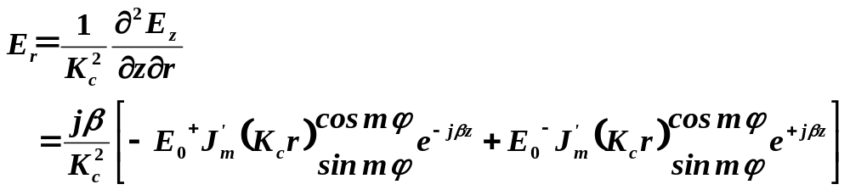
§6.4 Circular waveguide cavities
（2）TM_{mnp}

Slide 6
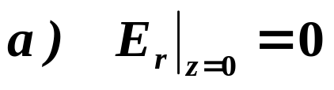

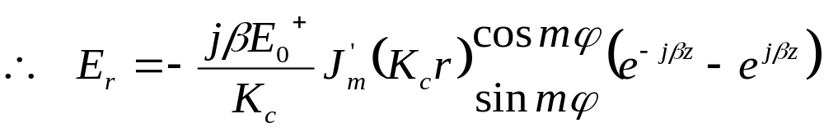
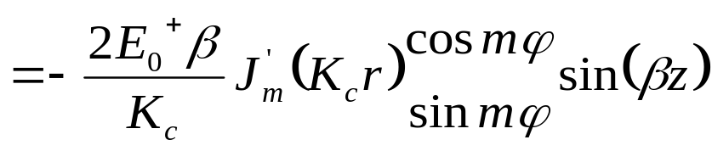
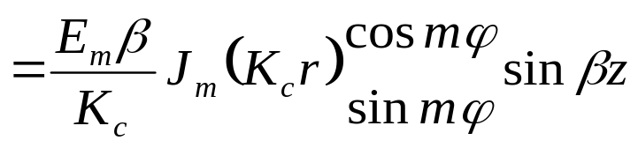
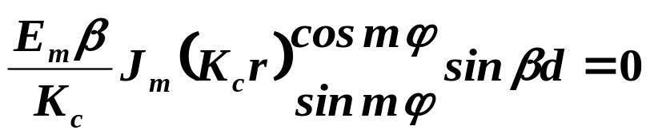
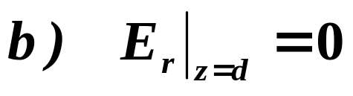
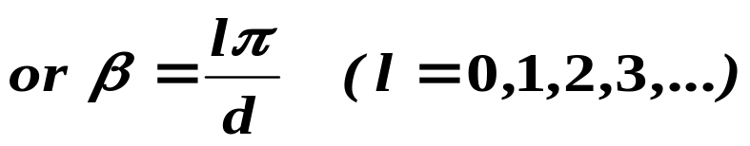
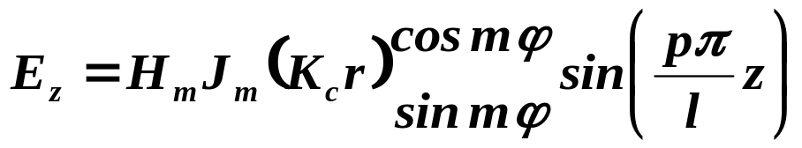
§6.4 Circular waveguide cavities

Slide 7
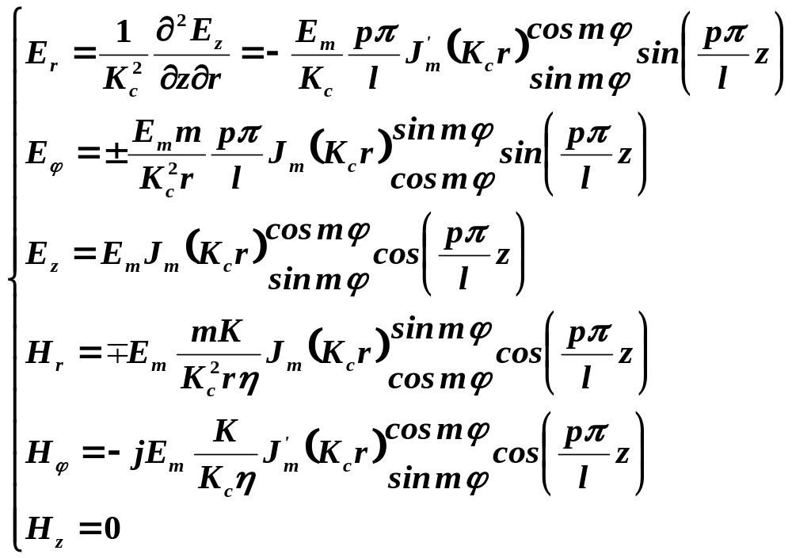
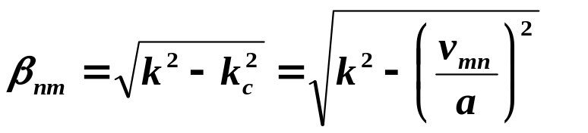
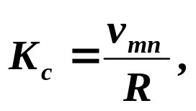
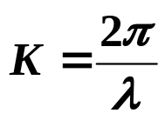
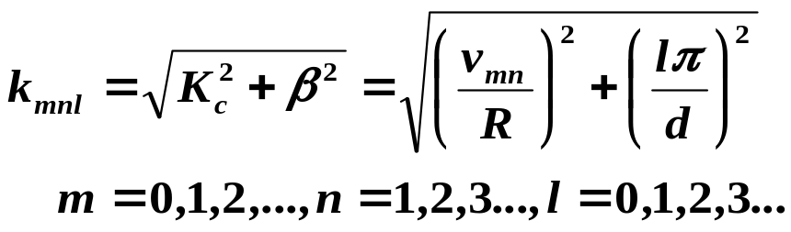
§6.4 Circular waveguide cavities

Slide 8

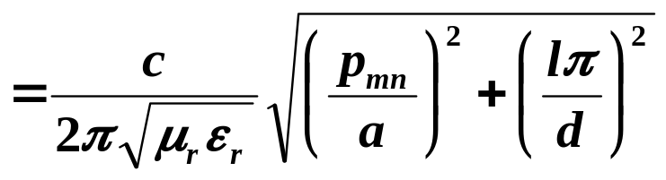
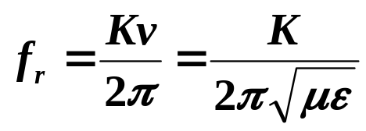
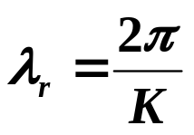
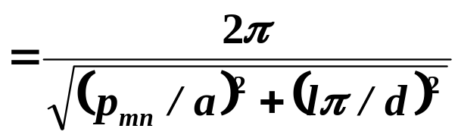
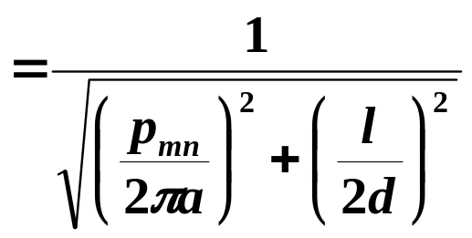
§6.4 Circular waveguide cavities
2 resonant frequency
The dominant TE mode is the TE111 mode
The dominant TM mode is the TM₁₁₀ mode

Slide 9
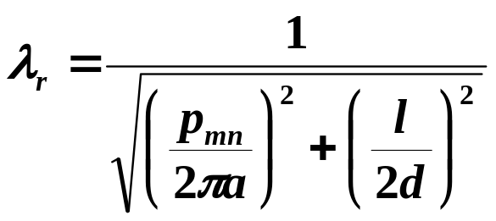
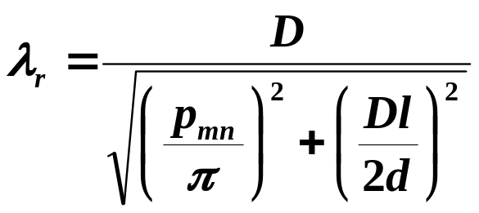

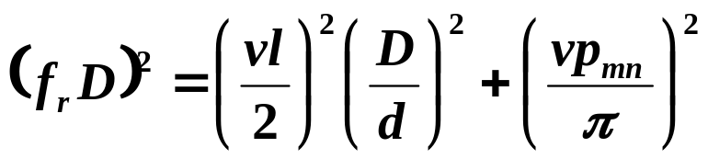
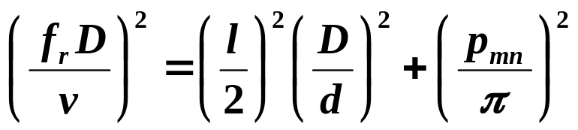
§6.4 Circular waveguide cavities
3 mode chart

Slide 10
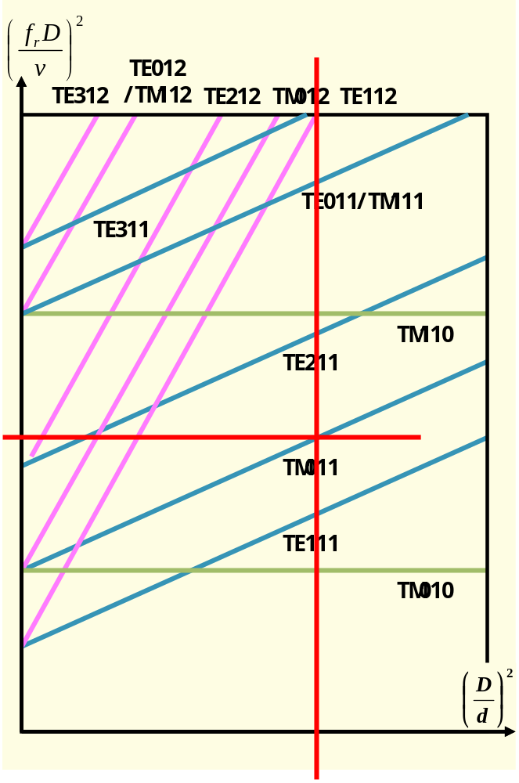
§6.4 Circular waveguide cavities
Resonant mode chart for a cylindrical cavity.

Slide 11
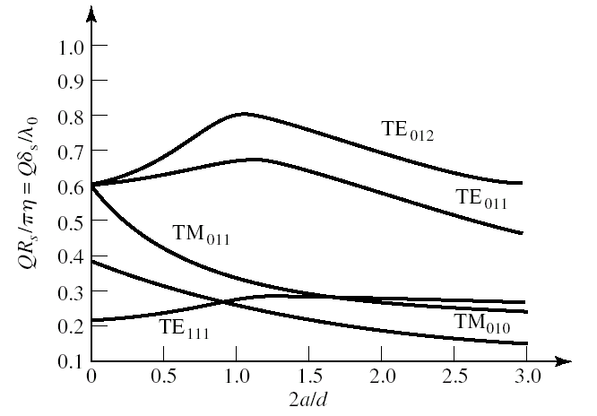
§6.4 Circular waveguide cavities
4. Q of the TE_{mnl} mode
Normalized Q for various cylindrical cavity modes (air-filled)

Slide 12
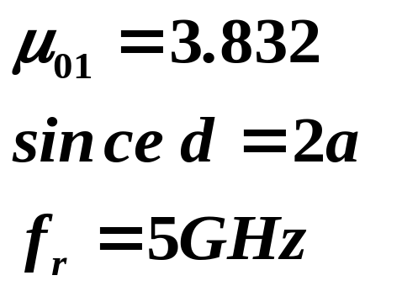
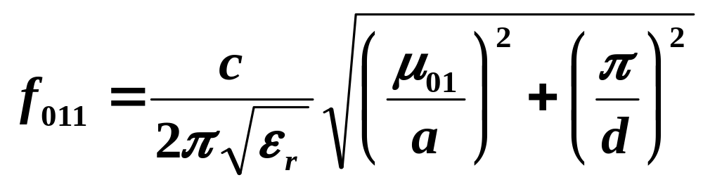
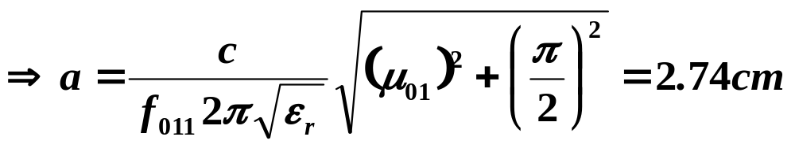

§6.4 Circular waveguide cavities
Example: Design of a circular cavity resonator
A circular cavity resonator with d=2a is to be designed to resonate at 5GHz in the TE011 mode. If the cavity is made from copper and is Teflon-filled (εr=2.25, tanδ= 0.0004), find its dimensions and Q
Solution：

Slide 13
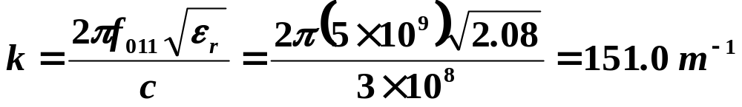
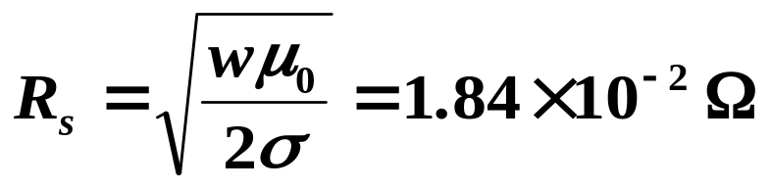
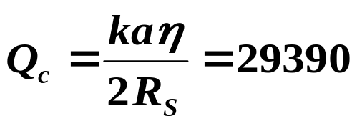
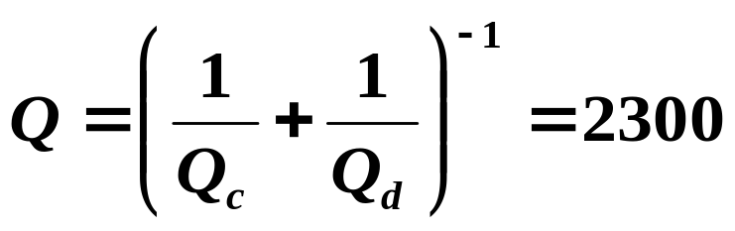
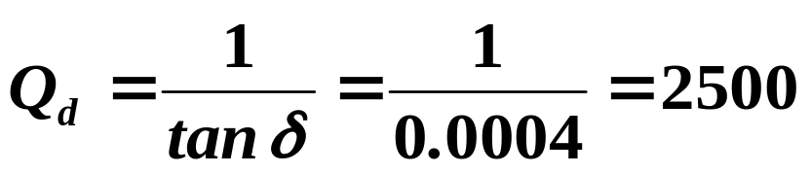
§6.4 Circular waveguide cavities
for m=0，n=1，l=1
compared with the rectangular cavity case
  Q=1927 for the TE101 mode
  Q=2065 forTE102 mode
If air-filled,the Q would increase to 42,400.

Slide 14




§6.4 Circular waveguide cavities
5. applications
（1）TE₀₁₁

Slide 15






§6.4 Circular waveguide cavities
（1）TE₁₁₁

Slide 16





§6.4 Circular waveguide cavities
（2）TM₀₁₀
If l<2.1R，TM₀₁₀ is dominant resonant mode；otherwise TE₁₁₁

Slide 17


§6.4 Circular waveguide cavities
Photograph of a W-band waveguide frequency meter. The knob rotates to change the length of the circuit-cavity resonator; the scale gives a readout of the frequency.

Slide 18



